Slide 1


Powering nonprofits to
respond to the crisis
Workshop
Managing your data in a pandemic: Using your data
14:00, 1 April, 2021
Martin Howitt & Lucy Knight, The Data Place
Joinbeyond.org | @join_beyond

Slide 2
Accessibility
Powering nonprofits to
respond to the crisis
We aim to offer the following accessibility support:
Images have descriptions
Add captions for video/audio content
Provide files in original format
Clear and clean presentations
Good video and audio quality
Please let your host know if you have any other needs or we can do something to improve your experience.
Joinbeyond.org | @join_beyond

Slide 3
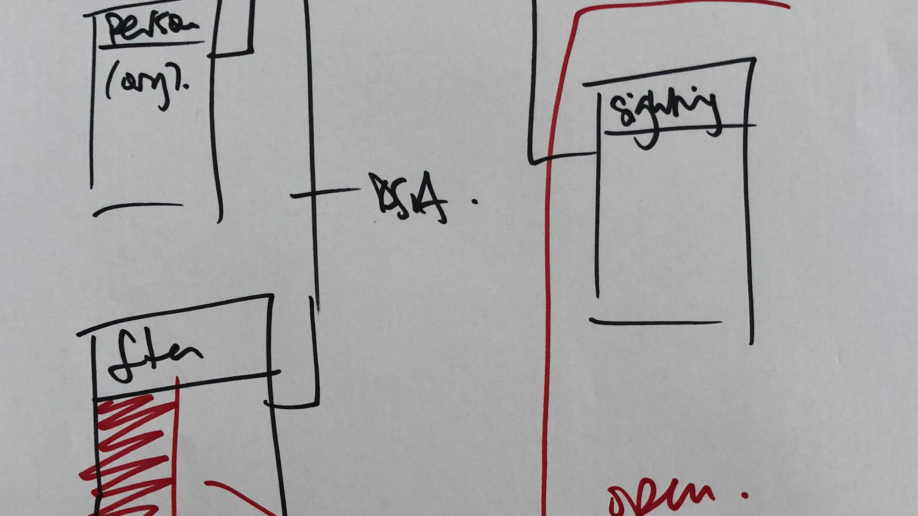

Using your Data
Notes:
Good afternoon and welcome to this workshop on your organisation’s data management.

Slide 4
Agenda
2:00 Welcome and Introductions
2:15 Session 1: Scenarios, data types and infrastructure
3:15 Break
3:30 Session 2: Maximising data value - benefits, infrastructure and data
4:30 Break
4:45 Session 3: Writing your own action plan
5:15 Round up and Q&A
5:30 Close
Notes:
3 and a half hours is a long time to be workshopping so we are going to take a couple of breaks on the way after each of the two exercises.

Slide 5
Objectives
After this session you will be able to:
Describe how you currently store and share data
Identify issues with storage and processing
List some free tools and open data that your organisation can make use of
Create an action plan for your organisation

Slide 6
About this workshop
Data use is a topic that gets bigger the more you look at it, and goes to the heart of running an organisation successfully, touching every single aspect of your operations.
We will try and give you both an overview and some tools to use straight away.
Possibly use the 1-1 sessions (there are still 2 slots available) if you need more targeted advice, and we’ll give you a reading list.

Slide 7
Introductions

Slide 8


Who we are
Lucy Knight
Martin Howitt
thedata.place @thedataplace

Slide 9
Who you are
Tell us a bit about yourself:
Your name
Where you're from
What you’re hoping to get from this session
thedata.place @thedataplace

Slide 10
Scenarios

Slide 11
Scenario 1
Alice uses a CRM recommended by a friend who works in a similar organisation.
But the standard reports don’t supply the information Alice needs, so she spends five hours every week exporting the data to Excel and rearranging it so she can create her own charts.
Notes:
Discussion on each scenario: does this seem familiar? Been in this situation? What happened?

Slide 12
Scenario 2
Bob knows where all the data is and how it fits together, and has created a set of macros and a Microsoft Access database with all the reporting the organisation needs. It’s a perfect system built up over many years.
Bob is due to retire soon, and nobody else knows how to maintain his system.
Notes:
Discussion on each scenario: does this seem familiar? Been in this situation? What happened?

Slide 13
Scenario 3
Charlie’s senior manager wants to spend some funding before year end and decides to replace the current infrastructure with a sophisticated ‘data lake’ and multi-platform reporting tool.
Unfortunately the funding can only be spent on assets, with no money left over for staff training. Charlie has to download all the data to a series of spreadsheets to get anything done.
Notes:
Discussion on each scenario: does this seem familiar? Been in this situation? What happened?

Slide 14
Poll: What are we using right now?
Notes:
Zoom poll followed by discussion - is this working? yes/no/maybe/sort-of and what are the issues?

Slide 15
Data structures
Notes:
We usually think of data as tables and spreadsheets, but that’s not the only structure.

Slide 16
Tabular
Spreadsheets.
Tables in documents.
Rows and columns, with one line per entity.
 | A | B | C | D | E
1
2
3
4
5
6
7
8
9
Notes:
Pros: easy to use and explain, can be opened in many platforms eg excel
Cons: limitations when relationships between entities are more complex e.g. one to many

Slide 17
Relational
role_id | role_name
0 | Staff - general
1 | Staff - Manager
2 | Staff - Volunteer
3 | Client - referred
4 | Client - self referred
5 | Supplier
person_id | name | role_id
44 | Anil | 1
46 | Bob | 1
77 | Charlie | 0
83 | Derek | 2
11 | Emma | 2
04 | Frank | 2
56 | Gerry | 3
42 | Harmil | 4
99 | Iyada | 3
78 | Jen | 5
Customer Relationship Management systems (CRMs)
Products and sales
Time management
Finance
Notes:
Pros: Reduce duplication of common fields, allow definition of reference values that many tables can use
Cons: require knowledge of coding languages (SQL and variants) to get your data back out and create reports

Slide 18
Hierarchy
Structured mark-up languages (e.g. XML and HTML)
Javascript object notation (JSON)
{
team_name: “Finance”,
manager: “Charlie”,
members:
{
name: “Anil”,
name: “Bob”,
name: “Hannah”
}
}
Notes:
Pros: well structured, machine readable - used in web pages and applications for that reason, and good for accessibility
Cons: finicky, one misplaced comma or curly bracket and nothing works. users need to learn the correct syntax.

Slide 19
Network
Relationships (personal and organisational)
Transmission of messages, information etc
Notes:
Pros: ideal for scenarios where an entity can have many different relationships, and different types of relationships, with multiple other entities
Cons: requires radically different storage, processing and handling to the other types. steep learning curve for beginners.

Slide 20
Geospatial
Locations and boundaries
Point, line or polygon
Special case: can be tabular, hierarchical, relational AND network
Notes:
Pros: ideal for defining and showing where things are
Cons: requires geospatial software to get the full value from it, which can be complex to master.

Slide 21
Data storage

Slide 22
Flat files
can be opened with a simple text editor like Notepad.
no formatting, so they take up far less space.
preferred option if you use code for your analyses.
Most commonly CSV (tabular) and XML or JSON (hierarchical).

Slide 23
Spreadsheets
Can be opened with specific software packages
90% of all operational data
Versatile and powerful
Good enough for lots of things
Can generate uncontrolled copies
Notes:
Excel is best software ever written. According to Martin

Slide 24
Relational databases
SQL, Postgres, MySQL and others
90% of all structured data in business systems uses this kind of format.
Data is stored in linked tables and queried using Structured Query Language (SQL).
Easy to understand and use, but doesn’t always map onto the real world perfectly.

Slide 25
noSQL databases
These come in different types and are an emerging class of database, developed to overcome limitations of SQL-based databases.
Document based (MongoDB)
Map/reduce, for very large datasets (Hadoop, others)
Graph databases (neo4J, others)
These databases are more for advanced users and specific applications.

Slide 26
Reporting and visualisation
Notes:
This is how you extract actual value - by analysing and visualising the data to pull out insights
we will you some suggestions/examples later for reference, but mainly we want to make the point that it matters how you plan to report on your data - it affects what data you collect and what formats you keep it in

Slide 27
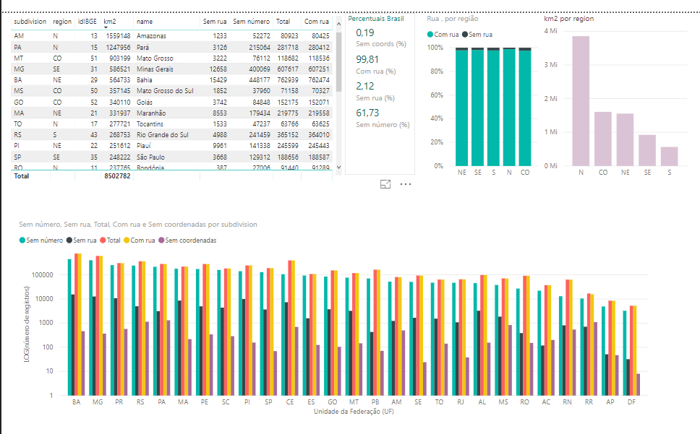
Power BI
Notes:
Things to look out for:
- ease of imports
- cleans up data itself
- clear visuals
- easy sharing

Slide 28
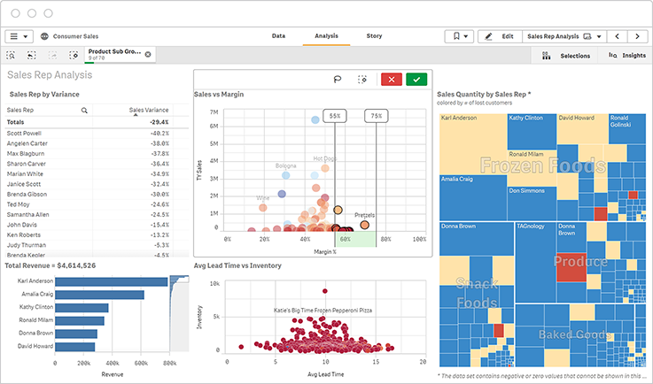
Qlik
Notes:
Things to look out for:
- ease of imports
- cleans up data itself
- clear visuals
- easy sharing

Slide 29
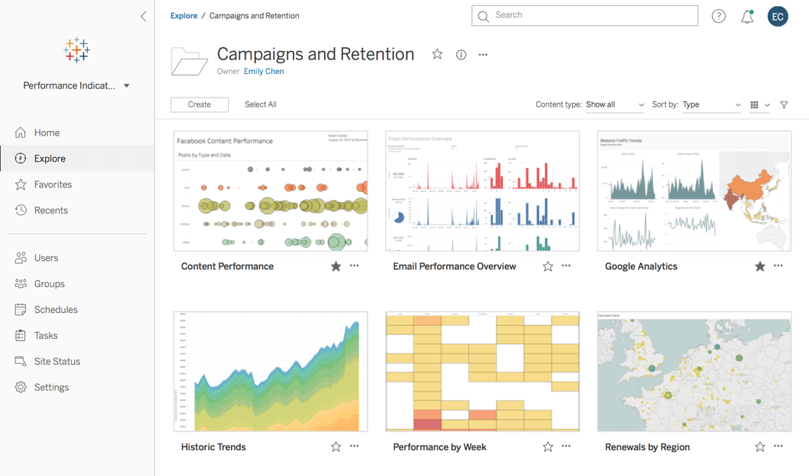
Tableau
Notes:
Things to look out for:
- ease of imports
- cleans up data itself
- clear visuals
- easy sharing

Slide 30
Ways to use data
Notes:
You may already do some of these things, but no-one does all of them. This section is to give you ideas. Are you doing any of these? are there some that you might think about? if so they’d end up on the action plan later

Slide 31
Understanding need
Understanding demographics and IMD data to evidence / compare the need for your service in different areas
Understanding existing service users and how they interact with you
Looking at trends to improve communication
This focus can bring a better understanding of how your service might change over time to respond to changing demand.

Slide 32
Understanding delivery and relationships
Using analytics in delivery channels to improve take-up of some services and also to monitor and tweak the effectiveness of promotional messages.
Using data-led marketing techniques to see what calls to action are the most effective.
Using survey data to inform relationship management.

Slide 33
Understanding impact
Measuring and evidencing impact for funders.
Using data to redesign services.
Measuring the effects a service has on a person.
Measuring the effects of a service change has on overall performance.

Slide 34
Understanding finance
Minimising costs.
Improving financial performance.
Knowing where money is going and coming from
Understanding cashflow
Building business cases for investments
Notes:
we aren’t finance experts but we do know the value of data to these disciplines

Slide 35
Understanding resourcing and operations
Predicting staff absences and tweaking delivery timings to reduce risk
Predicting seasonal demand for services.
Using weather forecasts to predict changes in demand or supply of volunteers.
Optimising internal staffing levels to maximise impact (eg ratios of support workers to clients.

Slide 36
Understanding partner relationships
Sharing forecasts with suppliers so they can lower risk and reduce costs.
Sharing analytics data with partners to verify conclusions.
Using data from commissioners to help shape services, and providing feedback data to them beyond statutory reporting.

Slide 37
Break

Slide 38
Exercise 1: Map your data estate
Notes:
may need to explain what we mean by data estate

Slide 39
Start with data flows
Build a basic flowchart
data comes in
data goes through
data goes out
Notes:
Wondering about using the BMC to prompt places that data might be brought to bear in the organisation ← yes, agreed

Slide 40
Define data types and formats
At each stage
What is the data about?
What type of data is it?
How is it stored?
What system/platform are you using?

Slide 41
Describe the purpose
For each dataset:
Why do you need it?
What job does it do?
What value does it add?
Notes:
Review:
Any surprises once you started mapping?
Views / anecdotes / thoughts?

Slide 42
Getting the most from your data

Slide 43

Storage and processing costs
Avoid paying for more complex systems, faster processing or more detailed data than you need.
Similarly, don’t introduce services or data you don’t have the capacity to take advantage of.
Image credit: Tool Dude www.mechanicalcaveman.com
Notes:
Sledgehammer to crack a nut

Slide 44
Efficiency
More advanced systems may seem like a good idea, but if they don’t meet your organisation’s needs you will spend more time creating workarounds.
Up to 80% of any data project is finding the data, cleaning it, and shaping it ready to be used for a final product.
80%

Slide 45

Accuracy
Moving data from one system or format to another introduces ‘vectors of error’ - situations where data can be altered.
Errors can often be invisible - until they start to impact service delivery.
If your data is in the right format, it’s easier to accurately model the scenarios the data represents.
Image credit: jeanmartin on Flickr

Slide 46
Do you have the right platform?
Notes:
Looking back at your flowcharts - do you feel like you have the right platform/s?
A look at the options, if the answer is No.
What would we recommend in each case?

Slide 47
Do you have the right data?
Notes:
A look at the options, if the answer is No.
What would we recommend in each case?

Slide 48
Using open data
Freely available for any purpose
Authoritative sources
Established provenance
Used and recognised by funders
Will save you time and money
Notes:
we discussed some of this last week, but let’s take a closer look at the potential benefits.
if you need more/different data, your options are 1. create it, 2. buy it or 3. find what someone else has created and get permission to use it
takes time
takes money
all you need is to find out if you have permission
open data comes with permission as a default, look for open licences like OGL and CC BY

Slide 49
Using open data
Our recommendations:
Indices of Multiple Deprivation (IMD)
Population projections
Annual Survey of Hours and Earnings (ASHE)
Open Corporates (businesses)
Postcodes and administrative boundaries (geospatial)
Notes:
a quick look at data mince and nomisweb

Slide 50
BREAK

Slide 51
Exercise 2: Write your action plan

Slide 52
Action plan template
Data Usage Action Plan
 | Item to capture | Your answer | Example
 | What areas of the organisation am I focusing on? |  | Activities
 | What is the opportunity? |  | Reducing the time it takes to generate monthly reports for funders
 | Why is it important? |  | Currently takes 3-4 days to extract, arrange and analyse the data from our CRM. Time taken away from actual service delivery.
 | What needs to happen? |  | Write a report from the CRM that provides the information exactly as we need it.
 | Who will do the work? |  | Preferably in-house so we retain the knowledge
 | Will you or your staff need training? |  | Someone will need to learn SQL
 | Do you need different equipment or software? |  | No, but we will need the report writer to have admin access
 | Do you have enough people? |  | Yes
 | How to address any shortfall ... |  | Get somebody trained
 | Next steps |  | Identify suitable training, allocate staff development budget, and arrange another admin account
Notes:
this might be a place for a modified BMC

Slide 53
Writing your action plan
What areas of the organisation am I focusing on?
What is the opportunity?
Why is it important?
What needs to happen?
Who will do the actual work?
Do you have the resources?
If not, how will you get them?
thedata.place @thedataplace
Notes:
Areas:
clients
channels
relationships
impact
activities
resources
partners

Slide 54
What we learned
How to:
Describe how you currently store and share data.
Identify issues with storage and processing.
List some free tools and open data that your organisation can make use of.
Create an action plan for your organisation.
thedata.place @thedataplace

Slide 55
Any questions?

Slide 56
What happens next?
How to reach us.
Resources we will share.
Next session.
thedata.place @thedataplace

Slide 57
Powering nonprofits to
respond to the crisis
Thanks!
Martin Howitt & Lucy Knight, The Data Place
thedata.place
@thedataplace
Joinbeyond.org | @join_beyond

